Slide 1


Slide 2

VIT
Topic/Course
Sub-Topic (Example: name of college)

Slide 3

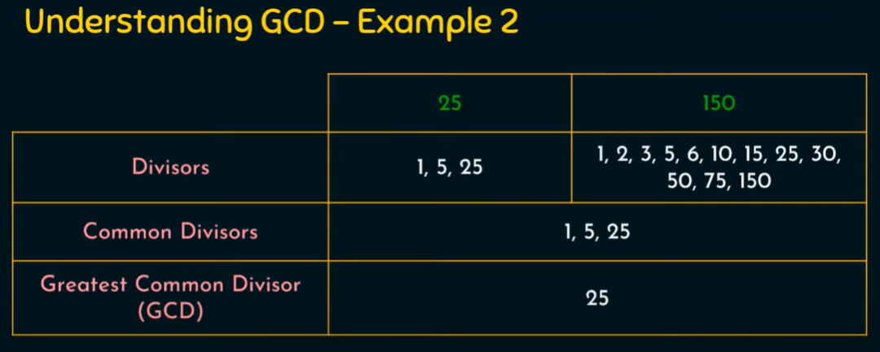


Slide 4
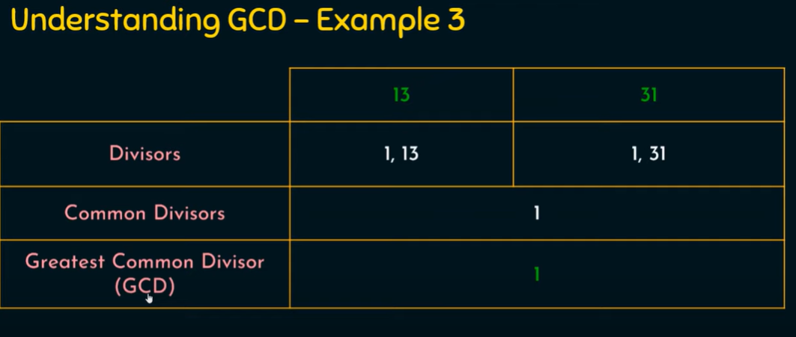


Slide 5

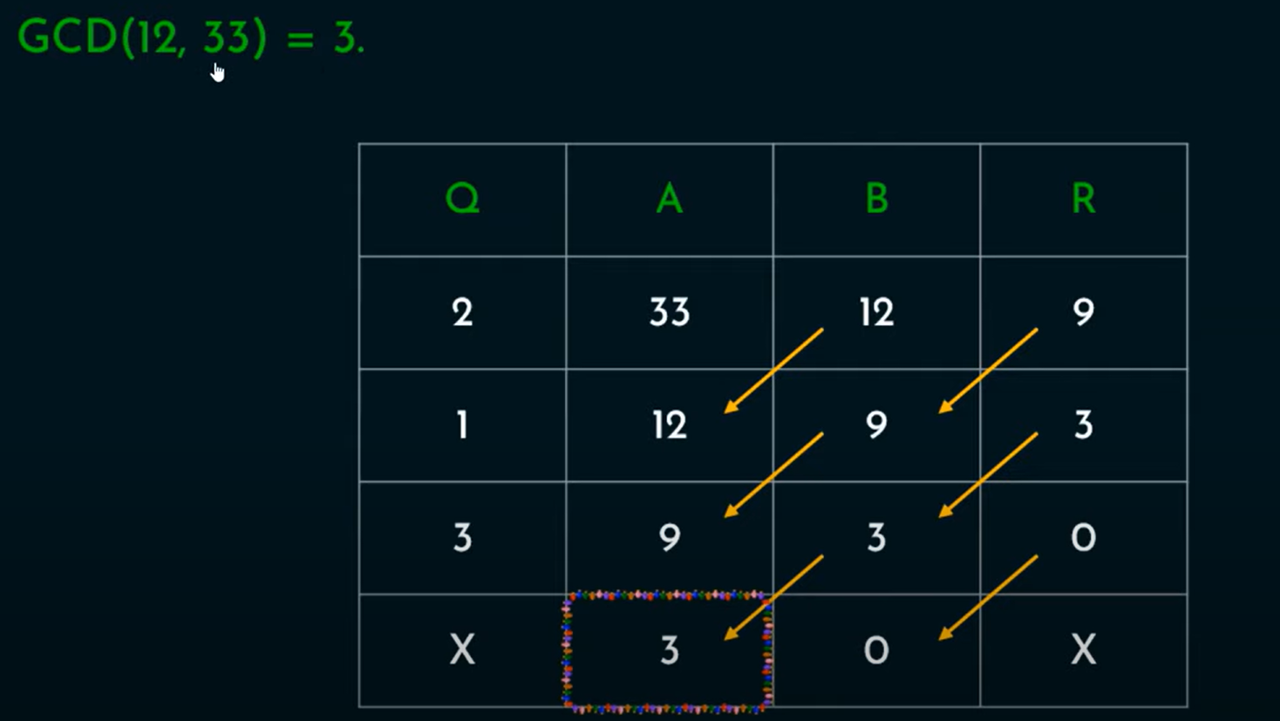

Slide 6
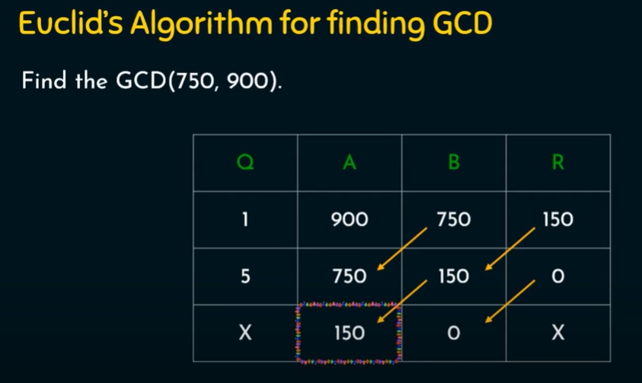

Slide 7
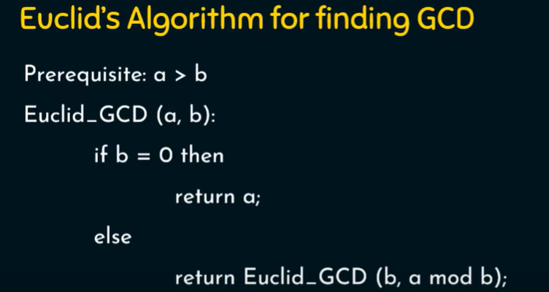

Slide 8
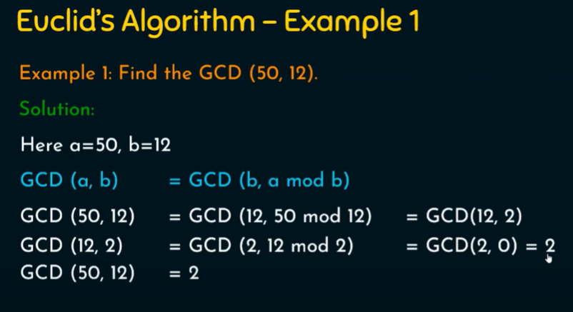

Slide 9
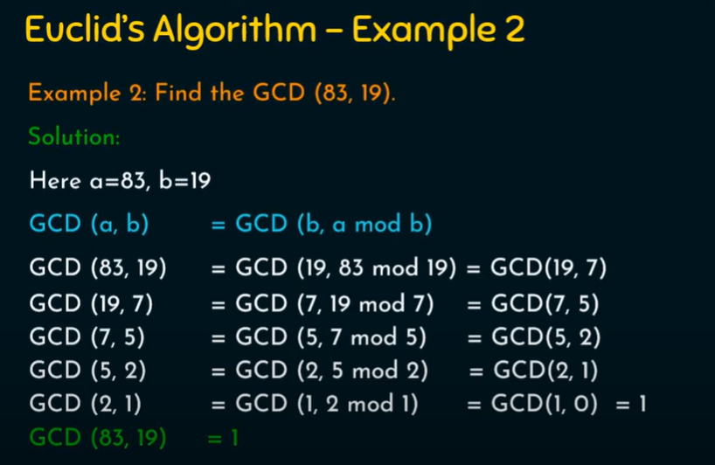

Slide 10
import java.util.*;
3
4 | public class GFG {
5
6 | public static int gcd(int a, int b)
7 | {
8 | if (a == 0)
9 | return b;
10
11 | return gcd(b % a, a);
12 | }
13
14 | // Driver code
15 | public static void main(String[] args)
16 | {
17 | int a = 50, b = 12, g;
18
19 | // Function call
20 | g = gcd(a, b);
21 | System.out.println("GCD(" + a + " , " + b
22 | + ") = " + g);
23
24 | }
25 | }

